Slide 1


Accelerate Your Data Career Through Community
@sadiestlawrence

Slide 2
What Comes To Mind When You Think Of Data Science?

Slide 3

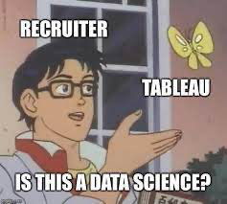
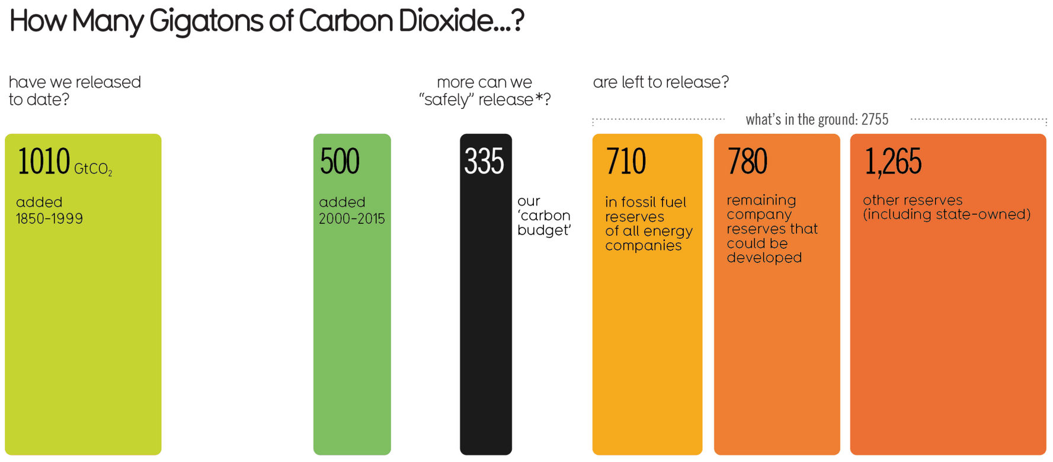
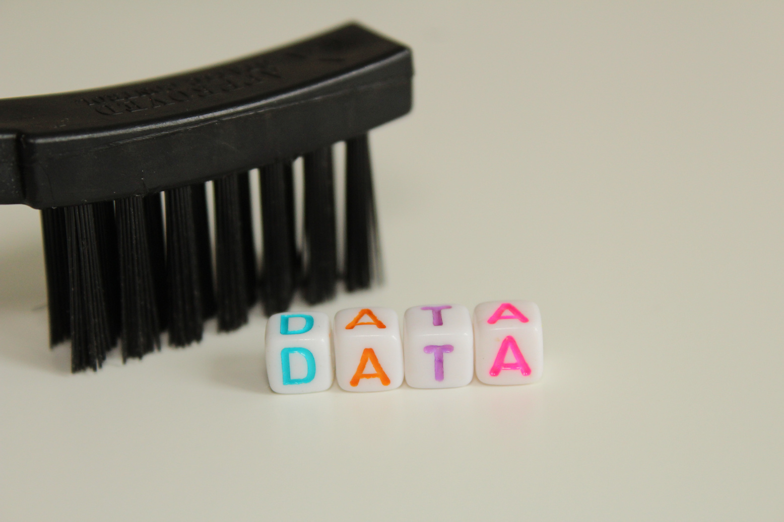


Slide 4


Slide 5

My Journey To Creating
Women in Data

Slide 6

WID'S HISTORY
From small beginnings to lasting impact, we believe in growing sustainably and investing in people for positive impact.
2015
2016
2017
2018
2019
2020
First chapter started in Sacramento
Tested new programs
Opened first sister chapter in San Francisco
Added four new chapters in Vancouver, Atlanta, Philadelphia, and NYC
Created Residency Program & Job Board.
Added 5 New Chapters
Added 30 New Chapters
Created Career Coaching Program
Created Mentorship Program

Slide 7
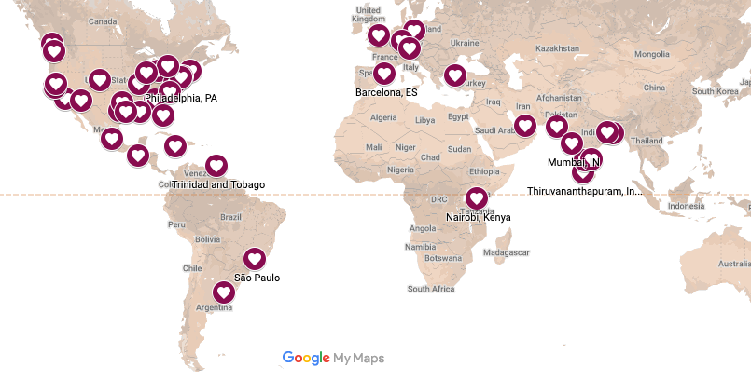
TODAY AT WOMEN IN DATA
Our Mission: Close the gender gap and increase diversity in data careers.
Our Chapters
We achieve our mission through our three pillars:
Awareness
Education
Advancement

Slide 8
How To Get Involved in Community

Slide 9



How To Get Involved in Community
Start with You!
Build a Work Resource Group
Join an Existing Community

Slide 10
How Community Elevates Your Data Career

Slide 11




How Community Elevates Your Data Career
Network
Learn from Others
Share Your Your Knowledge
Lead

Slide 12
WHAT YOU GET OUT OF COMMUNITY WILL DEPEND ON WHAT YOU GIVE TO COMMUNITY

Slide 13






Thank You
@sadiestlawrence

